Slide 1
CS 267
Dense Linear Algebra:
Parallel Gaussian Elimination
James Demmel
www.cs.berkeley.edu/~demmel/cs267_Spr08
3/3/2008
CS267 Guest Lecture 2

Slide 2
Outline
Motivation, overview for Dense Linear Algebra
Review Gaussian Elimination (GE) for solving Ax=b
Optimizing GE for caches on sequential machines
  using matrix-matrix multiplication (BLAS)
LAPACK library overview and performance
Data layouts on parallel machines
Parallel Gaussian Elimination
ScaLAPACK library overview
Eigenvalue problems
Current Research
3/3/2008
CS267 Guest Lecture 2

Slide 3
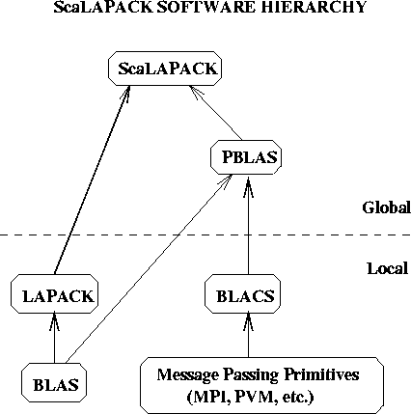
Sca/LAPACK Overview
3/3/2008
CS267 Guest Lecture 2

Slide 4

Success Stories for Sca/LAPACK
Widely used
  Adopted by Mathworks, Cray, Fujitsu, HP, IBM, IMSL, NAG, NEC, SGI, …
  >84M(56M in 2006) web hits @ Netlib (incl. CLAPACK, LAPACK95)
New Science discovered through the solution of dense matrix systems
  Nature article on the flat universe used ScaLAPACK
  Other articles in Physics Review B that also use it
  1998 Gordon Bell Prize
  www.nersc.gov/news/reports/newNERSCresults050703.pdf
Cosmic Microwave Background Analysis, BOOMERanG collaboration, MADCAP code (Apr. 27, 2000).
ScaLAPACK
3/3/2008
CS267 Guest Lecture 2
Notes:
These are two cover stories that direct results of numerical tools supported by NPACI.
SuperLU is a sparse linear system solver, and
ScaLAPACK is a dense and band solver for linear systems, least squares problems, eigenvalue problems, and singular value problems.
There are other more recent articles in places has Phys Rev B that use ScaLAPACK as well.

Slide 5
Motivation (1)
3 Basic Linear Algebra Problems
  Linear Equations: Solve Ax=b for x
  Least Squares: Find x that minimizes ||r||₂ ≡ √Σ r_{i}² where r=Ax-b
    Statistics: Fitting data with simple functions
  3a. Eigenvalues: Find λ and x where Ax = λ x
    Vibration analysis, e.g., earthquakes, circuits
  3b. Singular Value Decomposition: A^{T}Ax=σ²x
    Data fitting, Information retrieval
  Lots of variations depending on structure of A
    A symmetric, positive definite, banded, …
3/3/2008
CS267 Guest Lecture 2

Slide 6
Motivation (2)
Why dense A, as opposed to sparse A?
  Many large matrices are sparse, but …
  Dense algorithms easier to understand
  Some applications yields large dense matrices
  LINPACK Benchmark (www.top500.org)
    “How fast is your computer?” = “How fast can you solve dense Ax=b?”
  Large sparse matrix algorithms often yield smaller (but still large) dense problems
3/3/2008
CS267 Guest Lecture 2

Slide 7
Current Records for Solving Dense Systems (2007)
www.netlib.org, click on Performance Database Server
Gigaflops
Machine n=100 n=1000 Any n Peak
IBM BlueGene/L 478K 596K
(213K procs) (478 Teraflops)
(n=2.5M)
NEC SX 8
(8 proc, 2 GHz) 75.1 128
(1 proc, 2 GHz) 2.2 15.0 16
…
Palm Pilot III .00000169
(1.69 Kiloflops)
3/3/2008
CS267 Guest Lecture 2
Notes:
Efficiency of NEC SX8 at n=1000 = (75140/14960)/8 = .63

Slide 8
Gaussian Elimination (GE) for solving Ax=b
Add multiples of each row to later rows to make A upper triangular
Solve resulting triangular system Ux = c by substitution
… for each column i
… zero it out below the diagonal by adding multiples of row i to later rows
for i = 1 to n-1
… for each row j below row i
for j = i+1 to n
… add a multiple of row i to row j
tmp = A(j,i);
for k = i to n
A(j,k) = A(j,k) - (tmp/A(i,i)) * A(i,k)
0
.
.
.
0
0
.
.
.
0
0
.
.
.
0
…
0
.
.
.
0
0
.
.
.
0
0
.
.
.
0
0
.
.
.
0
0
.
0
0
.
0
0
0
0
After i=1
After i=2
After i=3
After i=n-1
3/3/2008
CS267 Guest Lecture 2

Slide 9
Refine GE Algorithm (1)
Initial Version
Remove computation of constant tmp/A(i,i) from inner loop.
… for each column i
… zero it out below the diagonal by adding multiples of row i to later rows
for i = 1 to n-1
… for each row j below row i
for j = i+1 to n
… add a multiple of row i to row j
tmp = A(j,i);
for k = i to n
A(j,k) = A(j,k) - (tmp/A(i,i)) * A(i,k)
for i = 1 to n-1
for j = i+1 to n
m = A(j,i)/A(i,i)
for k = i to n
A(j,k) = A(j,k) - m * A(i,k)
m
3/3/2008
CS267 Guest Lecture 2

Slide 10
Refine GE Algorithm (2)
Last version
Don’t compute what we already know: zeros below diagonal in column i
for i = 1 to n-1
for j = i+1 to n
m = A(j,i)/A(i,i)
for k = i to n
A(j,k) = A(j,k) - m * A(i,k)
for i = 1 to n-1
for j = i+1 to n
m = A(j,i)/A(i,i)
for k = i+1 to n
A(j,k) = A(j,k) - m * A(i,k)
m
3/3/2008
CS267 Guest Lecture 2
Do not compute zeros

Slide 11
Refine GE Algorithm (3)
Last version
Store multipliers m below diagonal in zeroed entries for later use
for i = 1 to n-1
for j = i+1 to n
m = A(j,i)/A(i,i)
for k = i+1 to n
A(j,k) = A(j,k) - m * A(i,k)
for i = 1 to n-1
for j = i+1 to n
A(j,i) = A(j,i)/A(i,i)
for k = i+1 to n
A(j,k) = A(j,k) - A(j,i) * A(i,k)
m
3/3/2008
CS267 Guest Lecture 2
Store m here

Slide 12
Refine GE Algorithm (4)
Last version
for i = 1 to n-1
for j = i+1 to n
A(j,i) = A(j,i)/A(i,i)
for k = i+1 to n
A(j,k) = A(j,k) - A(j,i) * A(i,k)
Split Loop
for i = 1 to n-1
for j = i+1 to n
A(j,i) = A(j,i)/A(i,i)
for j = i+1 to n
for k = i+1 to n
A(j,k) = A(j,k) - A(j,i) * A(i,k)
3/3/2008
CS267 Guest Lecture 2
Store all m’s here before updating rest of matrix

Slide 13
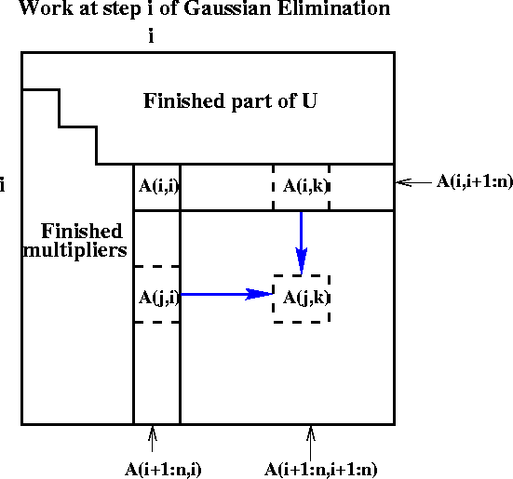
Refine GE Algorithm (5)
for i = 1 to n-1
for j = i+1 to n
A(j,i) = A(j,i)/A(i,i)
for j = i+1 to n
for k = i+1 to n
A(j,k) = A(j,k) - A(j,i) * A(i,k)
Last version
Express using matrix operations (BLAS)
for i = 1 to n-1
A(i+1:n,i) = A(i+1:n,i) * ( 1 / A(i,i) )
A(i+1:n,i+1:n) = A(i+1:n , i+1:n )
- A(i+1:n , i) * A(i , i+1:n)
3/3/2008
CS267 Guest Lecture 2

Slide 14
What GE really computes
Call the strictly lower triangular matrix of multipliers M, and let L = I+M
Call the upper triangle of the final matrix U
Lemma (LU Factorization): If the above algorithm terminates (does not divide by zero) then A = L*U
Solving A*x=b using GE
  Factorize A = L*U using GE (cost = 2/3 n³ flops)
  Solve L*y = b for y, using substitution (cost = n² flops)
  Solve U*x = y for x, using substitution (cost = n² flops)
Thus A*x = (L*U)*x = L*(U*x) = L*y = b as desired
for i = 1 to n-1
A(i+1:n,i) = A(i+1:n,i) / A(i,i)
A(i+1:n,i+1:n) = A(i+1:n , i+1:n ) - A(i+1:n , i) * A(i , i+1:n)
3/3/2008
CS267 Guest Lecture 2

Slide 15
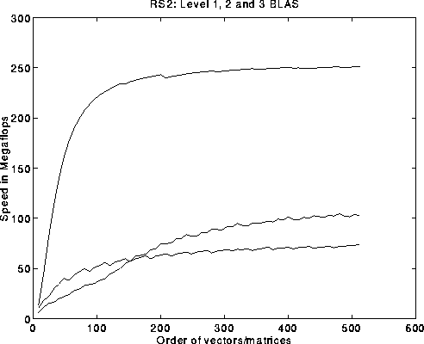
Problems with basic GE algorithm
What if some A(i,i) is zero? Or very small?
  Result may not exist, or be “unstable”, so need to pivot
Current computation all BLAS 1 or BLAS 2, but we know that BLAS 3 (matrix multiply) is fastest (earlier lectures…)
for i = 1 to n-1
A(i+1:n,i) = A(i+1:n,i) / A(i,i) … BLAS 1 (scale a vector)
A(i+1:n,i+1:n) = A(i+1:n , i+1:n ) … BLAS 2 (rank-1 update)
- A(i+1:n , i) * A(i , i+1:n)
Peak
BLAS 3
BLAS 2
BLAS 1
3/3/2008
CS267 Guest Lecture 2

Slide 16
Pivoting in Gaussian Elimination
A = [ 0 1 ] fails completely because can’t divide by A(1,1)=0
[ 1 0 ]
But solving Ax=b should be easy!
When diagonal A(i,i) is tiny (not just zero), algorithm may terminate but get completely wrong answer
  Numerical instability
  Roundoff error is cause
Cure: Pivot (swap rows of A) so A(i,i) large
3/3/2008
CS267 Guest Lecture 2

Slide 17
Gaussian Elimination with Partial Pivoting (GEPP)
Partial Pivoting: swap rows so that A(i,i) is largest in column
for i = 1 to n-1
find and record k where |A(k,i)| = max{i <= j <= n} |A(j,i)|
… i.e. largest entry in rest of column i
if |A(k,i)| = 0
exit with a warning that A is singular, or nearly so
elseif k != i
swap rows i and k of A
end if
A(i+1:n,i) = A(i+1:n,i) / A(i,i) … each |quotient| ≤ 1
A(i+1:n,i+1:n) = A(i+1:n , i+1:n ) - A(i+1:n , i) * A(i , i+1:n)
Lemma: This algorithm computes A = P*L*U, where P is a permutation matrix.
This algorithm is numerically stable in practice
For details see LAPACK code at
http://www.netlib.org/lapack/single/sgetf2.f
3/3/2008
CS267 Guest Lecture 2

Slide 18
Problems with basic GE algorithm
What if some A(i,i) is zero? Or very small?
  Result may not exist, or be “unstable”, so need to pivot
Current computation all BLAS 1 or BLAS 2, but we know that BLAS 3 (matrix multiply) is fastest (earlier lectures…)
for i = 1 to n-1
A(i+1:n,i) = A(i+1:n,i) / A(i,i) … BLAS 1 (scale a vector)
A(i+1:n,i+1:n) = A(i+1:n , i+1:n ) … BLAS 2 (rank-1 update)
- A(i+1:n , i) * A(i , i+1:n)
Peak
BLAS 3
BLAS 2
BLAS 1
3/3/2008
CS267 Guest Lecture 2

Slide 19
Converting BLAS2 to BLAS3 in GEPP
Blocking
  Used to optimize matrix-multiplication
  Harder here because of data dependencies in GEPP
BIG IDEA: Delayed Updates
  Save updates to “trailing matrix” from several consecutive BLAS2 updates
  Apply many updates simultaneously in one BLAS3 operation
Same idea works for much of dense linear algebra
  Open questions remain
First Approach: Need to choose a block size b
  Algorithm will save and apply b updates
  b must be small enough so that active submatrix consisting of b columns of A fits in cache
  b must be large enough to make BLAS3 fast
3/3/2008
CS267 Guest Lecture 2

Slide 20
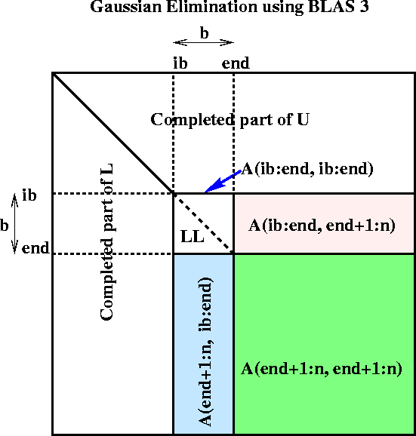
Blocked GEPP (www.netlib.org/lapack/single/sgetrf.f)
for ib = 1 to n-1 step b … Process matrix b columns at a time
end = ib + b-1 … Point to end of block of b columns
apply BLAS2 version of GEPP to get A(ib:n , ib:end) = P’ * L’ * U’
… let LL denote the strict lower triangular part of A(ib:end , ib:end) + I
A(ib:end , end+1:n) = LL⁻¹ * A(ib:end , end+1:n) … update next b rows of U
A(end+1:n , end+1:n ) = A(end+1:n , end+1:n )
- A(end+1:n , ib:end) * A(ib:end , end+1:n)
… apply delayed updates with single matrix-multiply
… with inner dimension b
(For a correctness proof, see on-line notes from CS267 / 1996.)
3/3/2008
CS267 Lecture 9
Notes:
Need to apply row interchanges from A(ib:n, ib:end) to trailing submatrix

Slide 21
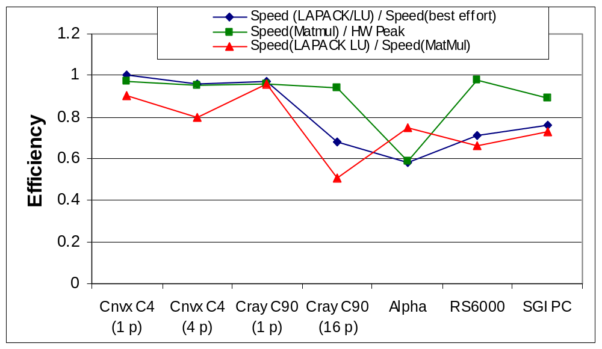
Efficiency of Blocked GEPP
(all parallelism “hidden” inside the BLAS)
3/3/2008
CS267 Guest Lecture 2

Slide 22
Outline of rest of talk
ScaLAPACK GEPP
Multicore GEPP
Rest of DLA what’s it like (not GEPP)
Missing from ScaLAPACK - projects
Design space more generally
projects
3/3/2008
CS267 Guest Lecture 2

Slide 23
Explicitly Parallelizing Gaussian Elimination
Parallelization steps
  Decomposition: identify enough parallel work, but not too much
  Assignment: load balance work among threads
  Orchestrate: communication and synchronization
  Mapping: which processors execute which threads (locality)
Decomposition
  In BLAS 2 algorithm nearly each flop in inner loop can be done in parallel, so with n² processors, need 3n parallel steps, O(n log n) with pivoting
  This is too fine-grained, prefer calls to local matmuls instead
  Need to use parallel matrix multiplication
Assignment and Mapping
  Which processors are responsible for which submatrices?
for i = 1 to n-1
A(i+1:n,i) = A(i+1:n,i) / A(i,i) … BLAS 1 (scale a vector)
A(i+1:n,i+1:n) = A(i+1:n , i+1:n ) … BLAS 2 (rank-1 update)
- A(i+1:n , i) * A(i , i+1:n)
3/3/2008
CS267 Guest Lecture 2

Slide 24
Different Data Layouts for Parallel GE
0 | 1 | 2 | 3
0 | 1 | 2 | 3 | 0 | 1 | 2 | 3 | 0 | 1 | 2 | 3 | 0 | 1 | 2 | 3
Bad load balance:
P0 idle after first
n/4 steps
Load balanced, but can’t easily use BLAS2 or BLAS3
1) 1D Column Blocked Layout
2) 1D Column Cyclic Layout
Can trade load balance
and BLAS2/3
performance by
choosing b, but
factorization of block
column is a bottleneck
0 | 1 | 2 | 3 | 0 | 1 | 2 | 3
0 | 1 | 2 | 3
3 | 0 | 1 | 2
2 | 3 | 0 | 1
1 | 2 | 3 | 0
Complicated addressing,
May not want full parallelism
In each column, row
b
4) Block Skewed Layout
3) 1D Column Block Cyclic Layout
Bad load balance:
P0 idle after first
n/2 steps
0 | 1
2 | 3
0 | 1 | 0 | 1 | 0 | 1 | 0 | 1
2 | 3 | 2 | 3 | 2 | 3 | 2 | 3
0 | 1 | 0 | 1 | 0 | 1 | 0 | 1
2 | 3 | 2 | 3 | 2 | 3 | 2 | 3
0 | 1 | 0 | 1 | 0 | 1 | 0 | 1
2 | 3 | 2 | 3 | 2 | 3 | 2 | 3
0 | 1 | 0 | 1 | 0 | 1 | 0 | 1
2 | 3 | 2 | 3 | 2 | 3 | 2 | 3
The winner!
6) 2D Row and Column Block Cyclic Layout
5) 2D Row and Column Blocked Layout
3/3/2008
CS267 Guest Lecture 2
Notes:
Another problem with Skewed Layout: BLAS3 updates all nonlocal!
Bad load balance in smaller trailing submatrices

Slide 25
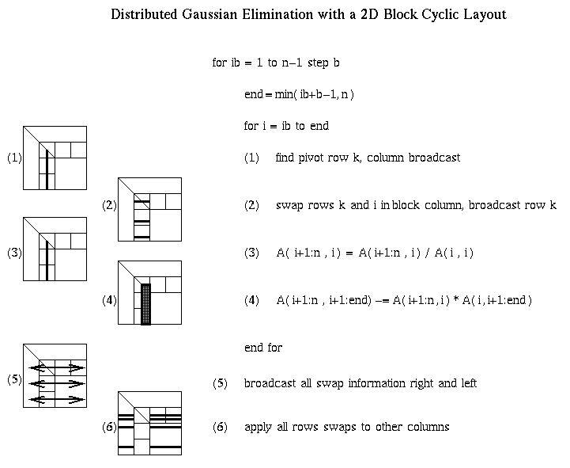
Distributed GE with a 2D Block Cyclic Layout
02/14/2006
CS267 Lecture 9

Slide 26
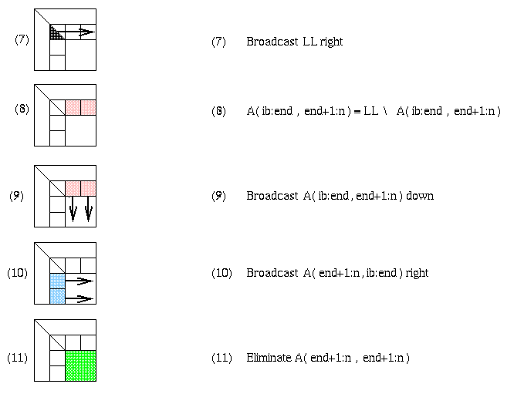
Matrix multiply of
green = green - blue * pink
02/14/2006
CS267 Lecture 9

Slide 27
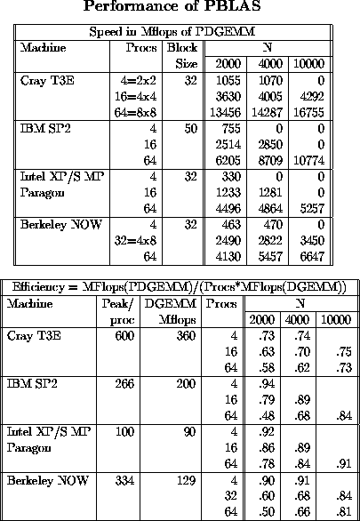
Review of Parallel MatMul
Want Large Problem Size Per Processor
PDGEMM = PBLAS matrix multiply
Observations:
For fixed N, as P increasesn Mflops increases, but less than 100% efficiency
For fixed P, as N increases, Mflops (efficiency) rises
DGEMM = BLAS routine
for matrix multiply
Maximum speed for PDGEMM
= # Procs * speed of DGEMM
Observations:
Efficiency always at least 48%
For fixed N, as P increases, efficiency drops
For fixed P, as N increases, efficiency increases
3/3/2008
CS267 Guest Lecture 2

Slide 28
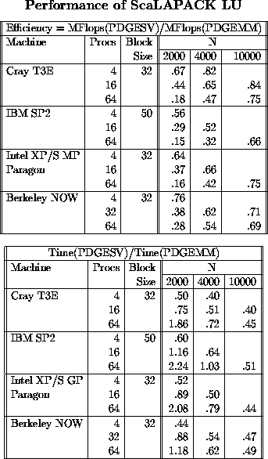
PDGESV = ScaLAPACK Parallel LU
Since it can run no faster than its
inner loop (PDGEMM), we measure:
Efficiency =
Speed(PDGESV)/Speed(PDGEMM)
Observations:
Efficiency well above 50% for large enough problems
For fixed N, as P increases, efficiency decreases (just as for PDGEMM)
For fixed P, as N increases efficiency increases (just as for PDGEMM)
From bottom table, cost of solving
  Ax=b about half of matrix multiply for large enough matrices.
  From the flop counts we would expect it to be (2*n³)/(2/3*n³) = 3 times faster, but communication makes it a little slower.
3/3/2008
CS267 Guest Lecture 2

Slide 29
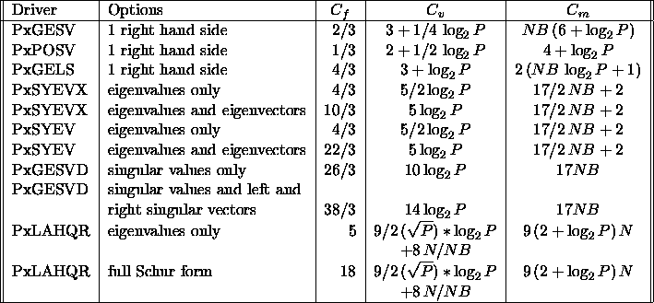
ScaLAPACK Performance Models (1)
ScaLAPACK Operation Counts
t_{f} = 1
t_{m} = α
t_{v} = β
ΝΒ = brow=bcol
√P = prow = pcol
3/3/2008
CS267 Guest Lecture 2
Notes:
Assume brow = bcol = NB, prow = pcol = sqrt(P)
t_f = time per flop , t_m = time per message = latency = alpha*t_f, t_v = time per word = 1/BW = beta*t_f
Note for GE: bandwidth term same as SUMMA (matmul), latency NB times larger

Slide 30
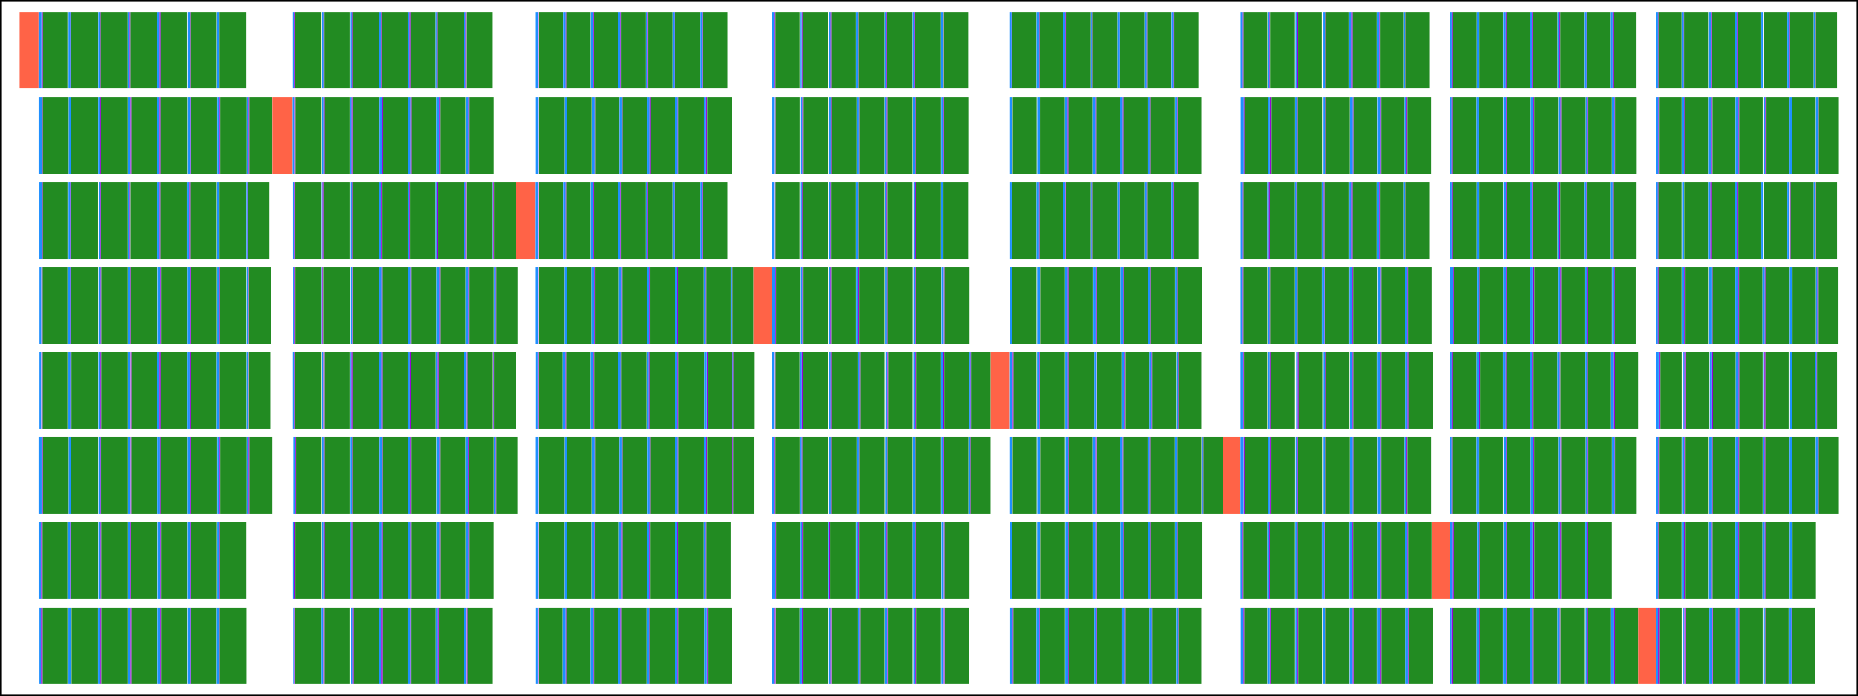
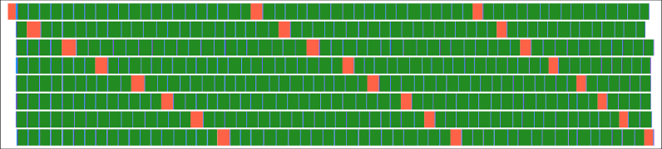
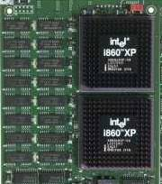
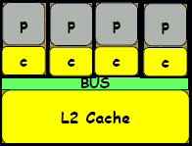
Fork-Join vs. Dynamic Execution
Source: Jack Dongarra
A
T
T
A
T
Fork-Join – parallel BLAS
B
C
C
Time
DAG-based – dynamic scheduling
Time
saved
Experiments on
Intel’s Quad Core Clovertown
with 2 Sockets w/ 8 Treads

Slide 31
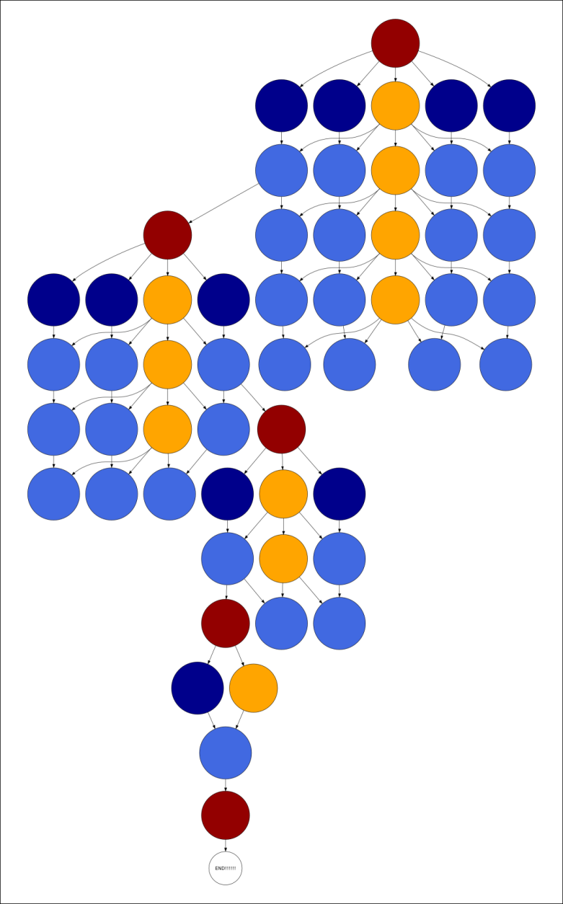
Achieving Asynchronicity
Source: Jack Dongarra
The matrix factorization can be represented as a DAG:
nodes: tasks that operate on “tiles”
edges: dependencies among tasks
Tasks can be scheduled asynchronously and in any order as long as dependencies are not violated.
System: PLASMA

Slide 32
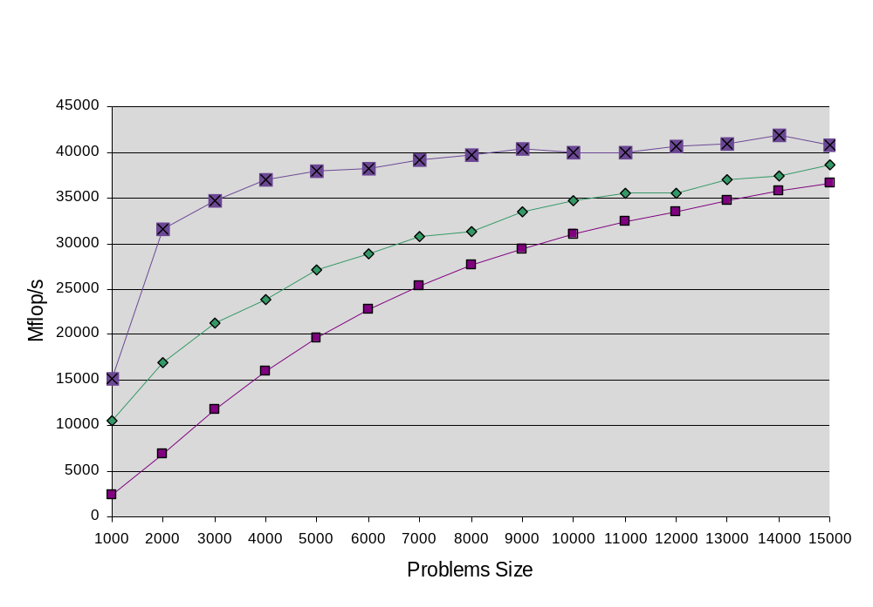
Intel’s Clovertown Quad Core
3 Implementations of LU factorization
Quad core w/2 sockets per board, w/ 8 Treads
Source: Jack Dongarra
3. DAG Based (Dynamic Scheduling)
2. ScaLAPACK (Mess Pass using mem copy)
1. LAPACK (BLAS Fork-Join Parallelism)
8 Core Experiments

Slide 33
LAPACK and ScaLAPACK Scalability
“One-sided Problems” are scalable
  Linear systems Ax=b, and least squares min_{x} ||Ax-b||₂
  In Gaussian elimination, A factored into product of 2 matrices A = LU by premultiplying A by sequence of simpler matrices
  Asymptotically 100% BLAS3
  LU (“Linpack Benchmark”)
  Cholesky, QR
“Two-sided Problems” are harder
  Eigenvalue problems, SVD
  A factored into product of 3 matrices by pre and post multiplication
  ~Half BLAS2, not all BLAS3
Narrow band problems hardest (to do BLAS3 or parallelize)
  Solving and eigenvalue problems
3/3/2008
CS267 Guest Lecture 2

Slide 34
What could go into a linear algebra library?
For all linear algebra problems
For all matrix/problem structures
For all data types
For all architectures and networks
For all programming interfaces
Produce best algorithm(s) w.r.t.
performance and accuracy
(including condition estimates, etc)
Need to prioritize, automate!
Notes:
For all linear algebra problems: Ax=b, least squares, eigenproblems, …
For all matrix structures: real symmetric banded….
For all data types: Single real, GMP complex,
For all architectures and networks: multicore chips, widening gaps between network, flops, overlap in network
For all programming interfaces (languages, libraries, PSIs)

Slide 35
Missing Routines in Sca/LAPACK
 |  | LAPACK | ScaLAPACK
Linear Equations | LU LU + iterative refine Cholesky LDL^{T} | xGESV xGESVX xPOSV xSYSV | PxGESV missing PxPOSV missing
Least Squares (LS) | QR QR+pivot SVD/QR SVD/D&C SVD/MRRR QR + iterative refine. | xGELS xGELSY xGELSS xGELSD missing missing | PxGELS missing missing missing (intent?) missing missing
Generalized LS | LS + equality constr. Generalized LM Above + Iterative ref. | xGGLSE xGGGLM missing | missing missing missing
Notes:
The comment “intent?” means that we suspect that we will not want to include
This routine because the MRRR-based could would be faster. But this remains
To be determined, and the evidence is that if you expect a lot of deflation in D&C,
It may well win. But this is very hard to tell before you run the problem.

Slide 36
More missing routines
 |  | LAPACK | ScaLAPACK
Symmetric EVD | QR / Bisection+Invit D&C MRRR | xSYEV / X xSYEVD xSYEVR | PxSYEV / X PxSYEVD missing
Nonsymmetric EVD | Schur form Vectors too | xGEES / X xGEEV /X | missing (driver) missing
SVD | QR D&C MRRR Jacobi | xGESVD xGESDD missing missing | PxGESVD missing (intent?) missing missing
Generalized Symmetric EVD | QR / Bisection+Invit D&C MRRR | xSYGV / X xSYGVD missing | PxSYGV / X missing (intent?) missing
Generalized Nonsymmetric EVD | Schur form Vectors too | xGGES / X xGGEV / X | missing missing
Generalized SVD | Kogbetliantz MRRR | xGGSVD missing | missing (intent) missing
Notes:
Even though new xSYEVR generally much faster than xSYEVD, we have not
Seen this in the parallel case; Bob Ward has PxSYEVD winning for his test cases.
Further testing is necessary.
We are pretty sure MRRR will beat Kogbetliantz (Jacobi) for the generalized SVD, and will
Not include a ScaLAPACK driver for Kogbetliantz.

Slide 37
Exploring the tuning space for Dense LA
Algorithm tuning space includes
  Underlying BLAS (PHiPAC, ATLAS)
  Different layouts (blocked, recursive, …) and algorithms
  Numerous block sizes, not just in underlying BLAS
  Many possible layers of parallelism, many mappings to HW
  Different traversals of underlying DAGs
    Synchronous and asynchronous algorithms
  “Redundant” algorithms for GPUs
  New and old eigenvalue algorithms
  Mixed precision (for speed or accuracy)
  New “communication avoiding” algorithms for variations on standard factorizations
Is there a concise set of abstractions to describe, generate tuning space?
  Block matrices, factorizations (partial, tree, …), DAGs, …
  PLASMA, FLAME, CSS, Spiral, Sequoia, Telescoping languages, Bernoulli, Rose, …
Question: What fraction of dense linear algebra can be generated/tuned?
  Lots more than when we started
    Sequential BLAS -> Parallel BLAS -> LU -> other factorizations -> …
  Most of dense linear algebra?
    Not eigenvalue algorithms (on compact forms)
    What fraction of LAPACK can be done?
    “for all linear algebra problems…”
  For all interesting architectures…?
Notes:
Multiple SW layers: BLAS/BLACS/PBLAS/LAPACK/ScaLAPACK
Multiple HW layers: multicore / vector / shared memory / distributed memory / heterogeneous cluster
Ex: should a single BLAS call use all the parallelism in an SMP and its multicore chips, or should it just use the multicore chips with individual ScaLAPACK processes mapping to different SMP nodes? Many combinations to explore, using performance modeling
Kathy Yelick’s keynote, Jack Dongarra’s minisymposium talk, HPL vs ScaLAPACK, all showed significant speedups for asynchronous LU.
PGAS = Partitioned Global Address Space languages: UPC, CAF, Titanium, (also Fortress, X10, Cascade?)
- Kathy Yelick keynote on Wed.
– we will prototype selected ScaLAPACK codes
Evidence is that LINPACK benchmark gets 2x improvement by aggressive asynchrony,
Is it even more for modest problem sizes, where comm relatively larger?
Lower communication costs for smaller messages, better match to networks by exploiting overlap from HW
Existing attempts at automation:
Telescoping languages (Kennedy et al)
Bernoulli (Pingali et al)
Rose (Quinlan et al)
FLAME (van de Geijn et al):

Slide 38
Possible class projects
GPU related
  Best results so far do some work on GPU, some on CPU
  Try porting algorithms to NVIDIA GPU using CUDA
  Explore mixed precision algorithms
Filling in gaps in ScaLAPACK
  User demand for various missing routines
Eigenvalues routines on Multicore
  Compare performance of LAPACK, ScaLAPACK
  Explore multithreaded implementations (PLASMA?)
New “communication avoiding” QR algorithm
  Implement, compare performance to Sca/LAPACK
  Try in eigenvalues routines
  Try analogous LU routine
Study code automation systems
  List on previous slide
More at
  www.cs.berkeley.edu/~demmel/Sca-LAPACK-Proposal.pdf
3/3/2008
CS267 Guest Lecture 2

Slide 39
Extra Slides
3/3/2008
CS267 Guest Lecture 2

Slide 40
Overview of LAPACK and ScaLAPACK
Standard library for dense/banded linear algebra
  Linear systems: A*x=b
  Least squares problems: min_{x} || A*x-b ||₂
  Eigenvalue problems: Ax = λx, Ax = λBx
  Singular value decomposition (SVD): A = UΣV^{T}
Algorithms reorganized to use BLAS3 as much as possible
Basis of math libraries on many computers, Matlab …
Many algorithmic innovations remain
  Projects available
02/14/2006
CS267 Lecture 9

Slide 41
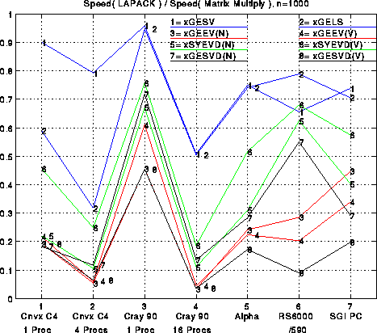
Performance of LAPACK (n=1000)
Performance of Eigen-values, SVD, etc.
02/14/2006
CS267 Lecture 9

Slide 42
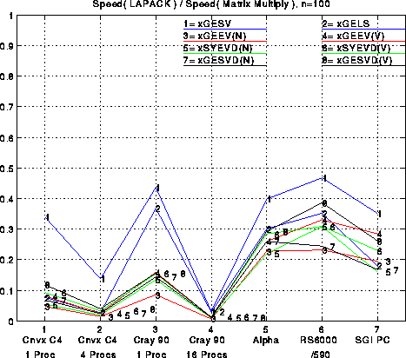
Performance of LAPACK (n=100)
Efficiency is much lower for a smaller matrix.
02/14/2006
CS267 Lecture 9

Slide 43
Review: BLAS 3 (Blocked) GEPP
for ib = 1 to n-1 step b … Process matrix b columns at a time
end = ib + b-1 … Point to end of block of b columns
apply BLAS2 version of GEPP to get A(ib:n , ib:end) = P’ * L’ * U’
… let LL denote the strict lower triangular part of A(ib:end , ib:end) + I
A(ib:end , end+1:n) = LL⁻¹ * A(ib:end , end+1:n) … update next b rows of U
A(end+1:n , end+1:n ) = A(end+1:n , end+1:n )
- A(end+1:n , ib:end) * A(ib:end , end+1:n)
… apply delayed updates with single matrix-multiply
… with inner dimension b
BLAS 3
02/14/2006
CS267 Lecture 9

Slide 44
Row and Column Block Cyclic Layout
processors and matrix blocks are distributed in a 2d array
  prow-by-pcol array of processors
  brow-by-bcol matrix blocks
pcol-fold parallelism in any column, and calls to the BLAS2 and BLAS3 on matrices of size brow-by-bcol
serial bottleneck is eased
prow ≠ pcol and brow ≠ bcol possible, even desireable
bcol
brow
0 | 1 | 0 | 1 | 0 | 1 | 0 | 1
2 | 3 | 2 | 3 | 2 | 3 | 2 | 3
0 | 1 | 0 | 1 | 0 | 1 | 0 | 1
2 | 3 | 2 | 3 | 2 | 3 | 2 | 3
0 | 1 | 0 | 1 | 0 | 1 | 0 | 1
2 | 3 | 2 | 3 | 2 | 3 | 2 | 3
0 | 1 | 0 | 1 | 0 | 1 | 0 | 1
2 | 3 | 2 | 3 | 2 | 3 | 2 | 3
02/14/2006
CS267 Lecture 9

Slide 45
Distributed GE with a 2D Block Cyclic Layout
block size b in the algorithm and the block sizes brow and bcol in the layout satisfy b=bcol.
shaded regions indicate processors busy with computation or communication.
unnecessary to have a barrier between each step of the algorithm, e.g.. steps 9, 10, and 11 can be pipelined
02/14/2006
CS267 Lecture 9

Slide 46
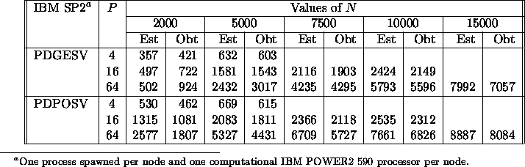
ScaLAPACK Performance Models (2)
Compare Predictions and Measurements
(LU)
(Cholesky)
02/14/2006
CS267 Lecture 9

Slide 47
Next release of LAPACK and ScaLAPACK
Class projects available
www.cs.berkeley.edu/~demmel/Sca-LAPACK-Proposal.pdf
New or improved LAPACK algorithms
  Faster and/or more accurate routines for linear systems, least squares, eigenvalues, SVD
Parallelizing algorithms for ScaLAPACK
  Many LAPACK routines not parallelized yet
Automatic performance tuning
  Many tuning parameters in code
02/14/2006
CS267 Lecture 9

Slide 48
Recursive Algorithms
Still uses delayed updates, but organized differently
  (formulas on board)
Can exploit recursive data layouts
  3x speedups on least squares for tall, thin matrices
Theoretically optimal memory hierarchy performance
See references at
  “Recursive Block Algorithms and Hybrid Data Structures,” Elmroth, Gustavson, Jonsson, Kagstrom, SIAM Review, 2004
  http://www.cs.umu.se/research/parallel/recursion/
02/14/2006
CS267 Lecture 9

Slide 49
Gaussian Elimination via a Recursive Algorithm
F. Gustavson and S. Toledo
LU Algorithm:
1: Split matrix into two rectangles (m x n/2)
if only 1 column, scale by reciprocal of pivot & return
2: Apply LU Algorithm to the left part
3: Apply transformations to right part
(triangular solve A₁₂ = L⁻¹A₁₂ and
matrix multiplication A₂₂=A₂₂ -A₂₁*A₁₂ )
4: Apply LU Algorithm to right part
L
A₁₂
A₂₁
A₂₂
Most of the work in the matrix multiply
Matrices of size n/2, n/4, n/8, …
02/14/2006
CS267 Lecture 9
Source: Jack Dongarra

Slide 50
Recursive Factorizations
Just as accurate as conventional method
Same number of operations
Automatic variable-size blocking
  Level 1 and 3 BLAS only !
Simplicity of expression
Potential for efficiency while being “cache oblivious”
  But shouldn’t recur down to single columns!
The recursive formulation is just a rearrangement of the point-wise LINPACK algorithm
The standard error analysis applies (assuming the matrix operations are computed the “conventional” way).
02/14/2006
CS267 Lecture 9

Slide 51
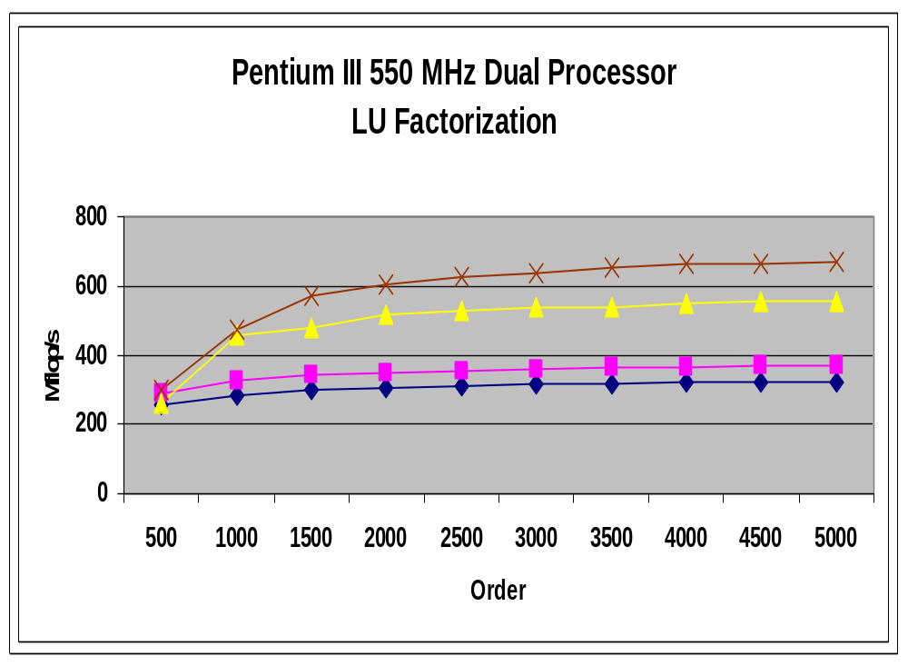
Recursive LU
Dual-processor
LAPACK
Recursive LU
LAPACK
Uniprocessor
02/14/2006
CS267 Lecture 9
Source: Jack Dongarra

Slide 52
Recursive Algorithms – Limits
Two kinds of dense matrix compositions
One Sided
  Sequence of simple operations applied on left of matrix
  Gaussian Elimination: A = L*U or A = P*L*U
    Symmetric Gaussian Elimination: A = L*D*L^{T}
    Cholesky: A = L*L^{T}
  QR Decomposition for Least Squares: A = Q*R
  Can be nearly 100% BLAS 3
  Susceptible to recursive algorithms
Two Sided
  Sequence of simple operations applied on both sides, alternating
  Eigenvalue algorithms, SVD
  At least ~25% BLAS 2
  Seem impervious to recursive approach?
  Some recent progress on SVD (25% vs 50% BLAS2)
02/14/2006
CS267 Lecture 9

Slide 53
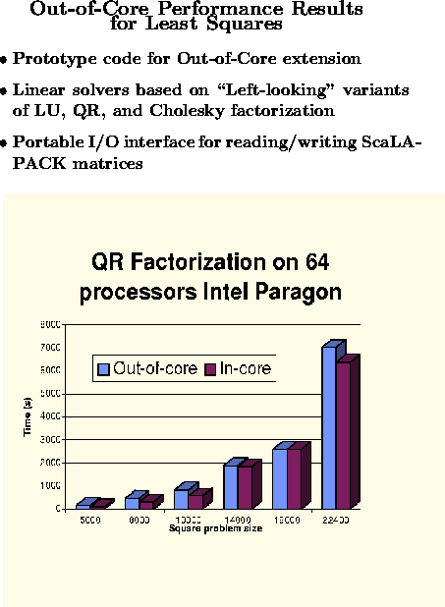
Out of “Core” Algorithms
Out-of-core means
matrix lives on disk;
too big for main memory
Much harder to hide
latency of disk
QR much easier than LU
because no pivoting
needed for QR
02/14/2006
CS267 Lecture 9
Source: Jack Dongarra

Slide 54
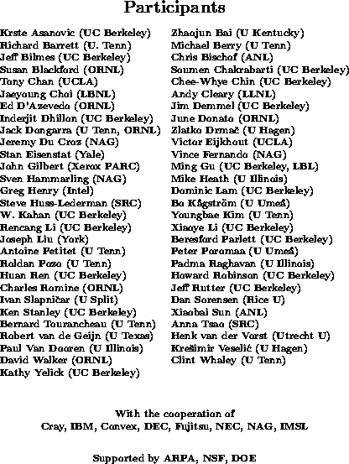
Some contributors (incomplete list)
02/14/2006
CS267 Lecture 9

Slide 55
Upcoming related talks
SIAM Conference on Parallel Processing in Scientific Computing
  San Francisco, Feb 22-24
  http://www.siam.org/meetings/pp06/index.htm
  Applications, Algorithms, Software, Hardware
  3 Minisymposia on Dense Linear Algebra on Friday 2/24
    MS41, MS47(*), MS56
Scientific Computing Seminar,
  “An O(n log n) tridiagonal eigensolver”, Jonathan Moussa
  Wednesday, Feb 15, 11-12, 380 Soda
Special Seminar
  Towards Combinatorial Preconditioners for Finite-Elements Problems”, Prof. Sivan Toledo, Technion
  Tuesday, Feb 21, 1-2pm, 373 Soda
02/14/2006
CS267 Lecture 9

Slide 56
Extra Slides
02/14/2006
CS267 Lecture 9

Slide 57
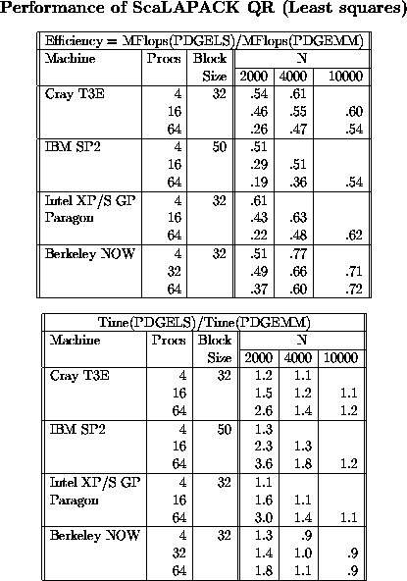
QR (Least Squares)
Scales well,
nearly full machine speed
02/14/2006
CS267 Lecture 9

Slide 58
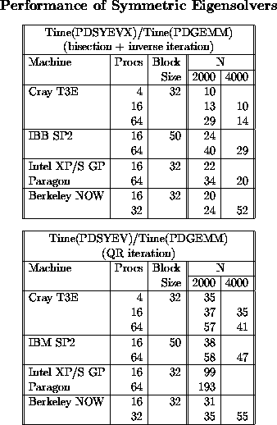
Current algorithm:
Faster than initial algorithm
Occasional numerical instability
New, faster and more stable
algorithm planned
Initial algorithm:
Numerically stable
Easily parallelized
Slow: will abandon
02/14/2006
CS267 Lecture 9

Slide 59
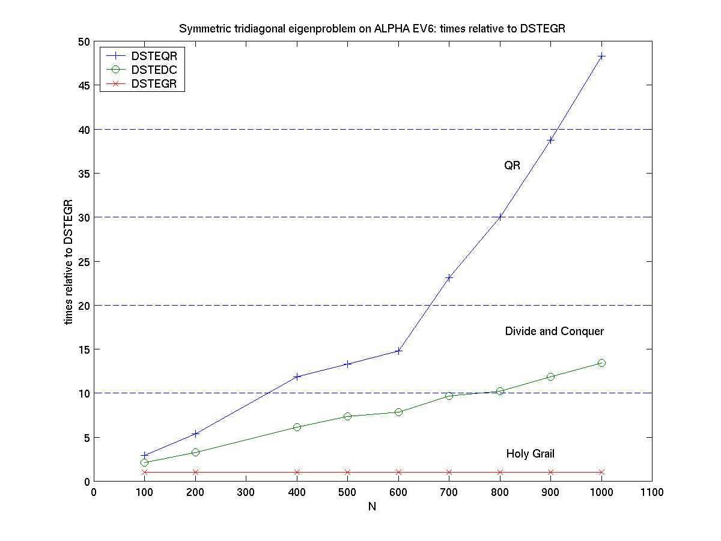
The “Holy Grail” (Parlett, Dhillon, Marques)
Perfect Output complexity (O(n * #vectors)), Embarrassingly parallel, Accurate
Scalable Symmetric Eigensolver and SVD
To be propagated throughout LAPACK and ScaLAPACK
02/14/2006
CS267 Lecture 9
Notes:
This compares two historical algorithms for finding eigenvalues of symmetric matrices, QR iteration
And Cuppen’s divide and conquer method, both of which are in LAPACK and ScaLAPACK, with a recent
Method we call the Holy Grail. The Holy Grail is normalzed to have time=1, so the other graphs show
How much slower the other algorithms are, up to 14x slower for divide-and-conquer, and 48x slower
For QR. We call the latest algorithms the Holy Grail because it has two optimalty properties:
First, To compute k n-dimensional eigenvectors, ie k*n numbers, it takes O(k*n) time.
Second, it is embarrassingly parallel, with each eigenvector computable independently.
The other two algorithms on the plot have higher complexity, and are harder to parallelize.
We are still working on propagating the new algorithm throughout LAPACK and ScaLAPACK
Into all the places it can go, which is quite a few.

Slide 60
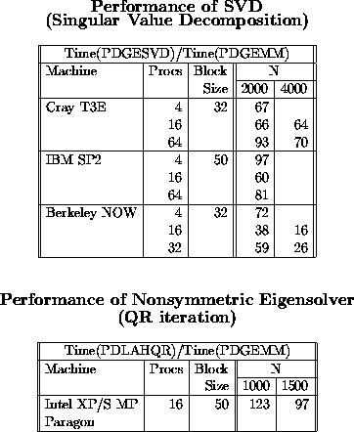
Have good ideas to speedup
Project available!
Hardest of all to parallelize
02/14/2006
CS267 Lecture 9

Slide 61
Scalable Nonsymmetric Eigensolver
Ax_{i} = λ_{i} x_{i} , Schur form A = QTQ^{T}
Parallel HQR
  Henry, Watkins, Dongarra, Van de Geijn
  Now in ScaLAPACK
  Not as scalable as LU: N times as many messages
  Block-Hankel data layout better in theory, but not in ScaLAPACK
Sign Function
  Beavers, Denman, Lin, Zmijewski, Bai, Demmel, Gu, Godunov, Bulgakov, Malyshev
  A_{i+1} = (A_{i} + A_{i}⁻¹)/2 → shifted projector onto Re λ > 0
  Repeat on transformed A to divide-and-conquer spectrum
  Only uses inversion, so scalable
  Inverse free version exists (uses QRD)
  Very high flop count compared to HQR, less stable
02/14/2006
CS267 Lecture 9

Slide 62
Assignment of parallel work in GE
Think of assigning submatrices to threads, where each thread responsible for updating submatrix it owns
  “owner computes” rule natural because of locality
What should submatrices look like to achieve load balance?
02/14/2006
CS267 Lecture 9

Slide 63
Computational Electromagnetics (MOM)
The main steps in the solution process are
Fill: computing the matrix elements of A
Factor: factoring the dense matrix A
Solve: solving for one or more excitations b
Field Calc: computing the fields scattered from the object
02/14/2006
CS267 Lecture 9

Slide 64
Analysis of MOM for Parallel Implementation
Task Work Parallelism Parallel Speed
Fill O(n**2) embarrassing low
Factor O(n**3) moderately diff. very high
Solve O(n**2) moderately diff. high
Field Calc. O(n) embarrassing high
02/14/2006
CS267 Lecture 9

Slide 65
BLAS2 version of GE with Partial Pivoting (GEPP)
for i = 1 to n-1
find and record k where |A(k,i)| = max{i <= j <= n} |A(j,i)|
… i.e. largest entry in rest of column i
if |A(k,i)| = 0
exit with a warning that A is singular, or nearly so
elseif k != i
swap rows i and k of A
end if
A(i+1:n,i) = A(i+1:n,i) / A(i,i)
… each quotient lies in [-1,1]
… BLAS 1
A(i+1:n,i+1:n) = A(i+1:n , i+1:n ) - A(i+1:n , i) * A(i , i+1:n)
… BLAS 2, most work in this line
02/14/2006
CS267 Lecture 9

Slide 66
Computational Electromagnetics – Solve Ax=b
Developed during 1980s, driven by defense applications
Determine the RCS (radar cross section) of airplane
Reduce signature of plane (stealth technology)
Other applications are antenna design, medical equipment
Two fundamental numerical approaches:
  MOM methods of moments ( frequency domain)
    Large dense matrices
  Finite differences (time domain)
    Even larger sparse matrices
02/14/2006
CS267 Lecture 9

Slide 67
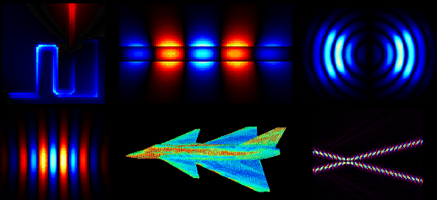
Computational Electromagnetics
- Discretize surface into triangular facets using standard modeling tools
- Amplitude of currents on surface are unknowns
- Integral equation is discretized into a set of linear equations
image: NW Univ. Comp. Electromagnetics Laboratory http://nueml.ece.nwu.edu/
02/14/2006
CS267 Lecture 9

Slide 68
Computational Electromagnetics (MOM)
After discretization the integral equation has the form
A x = b
where
A is the (dense) impedance matrix,
x is the unknown vector of amplitudes, and
b is the excitation vector.
(see Cwik, Patterson, and Scott, Electromagnetic Scattering on the Intel Touchstone Delta, IEEE Supercomputing ‘92, pp 538 - 542)
02/14/2006
CS267 Lecture 9

Slide 69
Results for Parallel Implementation on Intel Delta
Task Time (hours)
Fill (compute n² matrix entries) 9.20
(embarrassingly parallel but slow)
Factor (Gaussian Elimination, O(n³) ) 8.25
(good parallelism with right algorithm)
Solve (O(n²)) 2 .17
(reasonable parallelism with right algorithm)
Field Calc. (O(n)) 0.12
(embarrassingly parallel and fast)
The problem solved was for a matrix of size 48,672. 2.6 Gflops for Factor - The world record in 1991.
02/14/2006
CS267 Lecture 9

Slide 70
Computational Chemistry – Ax = λ x
Seek energy levels of a molecule, crystal, etc.
  Solve Schroedinger’s Equation for energy levels = eigenvalues
  Discretize to get Ax = λBx, solve for eigenvalues λ and eigenvectors x
  A and B large Hermitian matrices (B positive definite)
MP-Quest (Sandia NL)
  Si and sapphire crystals of up to 3072 atoms
  A and B up to n=40000, complex Hermitian
  Need all eigenvalues and eigenvectors
  Need to iterate up to 20 times (for self-consistency)
Implemented on Intel ASCI Red
  9200 Pentium Pro 200 processors (4600 Duals, a CLUMP)
  Overall application ran at 605 Gflops (out of 1800 Gflops peak),
  Eigensolver ran at 684 Gflops
  www.cs.berkeley.edu/~stanley/gbell/index.html
  Runner-up for Gordon Bell Prize at Supercomputing 98
02/14/2006
CS267 Lecture 9

Slide 71
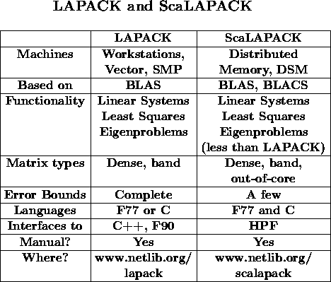
02/14/2006
CS267 Lecture 9

Slide 72
Parallelism in ScaLAPACK
Level 3 BLAS block operations
  All the reduction routines
Pipelining
  QR Iteration, Triangular Solvers, classic factorizations
Redundant computations
  Condition estimators
Static work assignment
  Bisection
Task parallelism
  Sign function eigenvalue computations
Divide and Conquer
  Tridiagonal and band solvers, symmetric eigenvalue problem and Sign function
Cyclic reduction
  Reduced system in the band solver
02/14/2006
CS267 Lecture 9

Slide 73
Winner of TOPS 500 (LINPACK Benchmark)
Year | Machine | Tflops | Factor faster | Peak Tflops | Num Procs | N
2004 | Blue Gene / L, IBM | 70.7 | 2.0 | 91.8 | 32768 | .93M
20022003 | Earth System Computer, NEC | 35.6 | 4.9 | 40.8 | 5104 | 1.04M
2001 | ASCI White, IBM SP Power 3 | 7.2 | 1.5 | 11.1 | 7424 | .52M
2000 | ASCI White, IBM SP Power 3 | 4.9 | 2.1 | 11.1 | 7424 | .43M
1999 | ASCI Red, Intel PII Xeon | 2.4 | 1.1 | 3.2 | 9632 | .36M
1998 | ASCI Blue, IBM SP 604E | 2.1 | 1.6 | 3.9 | 5808 | .43M
1997 | ASCI Red, Intel Ppro, 200 MHz | 1.3 | 3.6 | 1.8 | 9152 | .24M
1996 | Hitachi CP-PACS | .37 | 1.3 | .6 | 2048 | .10M
1995 | Intel Paragon XP/S MP | .28 | 1 | .3 | 6768 | .13M
02/14/2006
CS267 Lecture 9
Source: Jack Dongarra (UTK)

